Slide 1
The Complete RFID Solution
Total Hospital Access Control, Tracking, & Asset Management

Slide 2
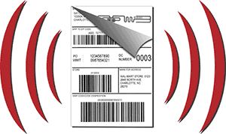

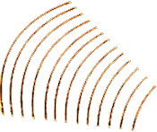
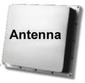

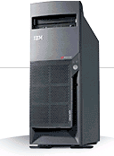

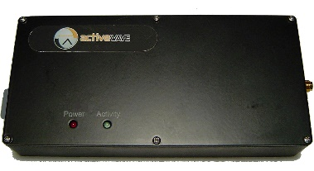

RFID - what are the components?
Active & Passive RFID tags respond to readers with unique IDs:
RFID Tags
Chip
Antenna
Packaging or substrate
RFID tag
enterprise Integration
Host System
RFID Middleware
RFID Reader

Slide 3
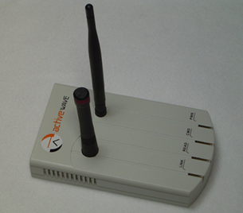
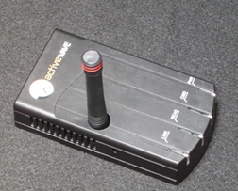
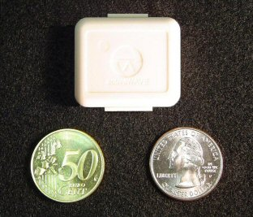
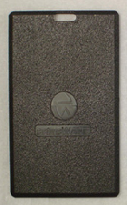
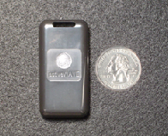
Active Technology
Components
Reader
Listens for Tag beacons, can call individual tags
Programs tags with ID and how to behave
Has built in Field Generator
Full Duplex – broadcasts at 433Mhz and listens
on 916Mhz
Field Generator
Sends out signal and wakes up active tags
Transmit range configurable to match zone
Periodic or sensor based activation
Tags
Various types to match application
Can have onboard LED and/or Alarm
Smaller you go, the shorter the range
Can track temperature and tampering

Slide 4
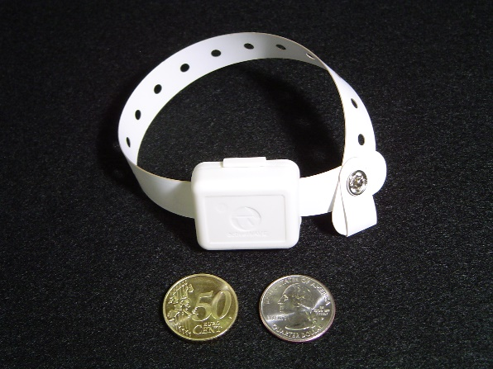
Active Tags
Mini-Tag
100’ transmit range
Small parts
Compact Tag
145’ transmit range
Monitors, wheelchairs, etc.
Card Tag
Thin footprint - ideal for access control badge
280’ transmit range
Wristband tag
Access control
Monitor Temperature
Tamper proof

Slide 5
Active Technology - Modes of Operation
Beacon mode
Tag wakes up at given intervals and reports “I’m here”.
Periodic mode
Reader or Field Generator periodically transmits a command to Tag. Tag responds back to Reader.
User-configurable ON and OFF times.
Trigger mode
Reader or Field Generator calls a Tag when an external event happens, e.g., motion sensor activation.
User mode
User initiates Tag call from computer.
Can call all tags, specific tag type, specific tag ID range, or specific tag ID and type.

Slide 6
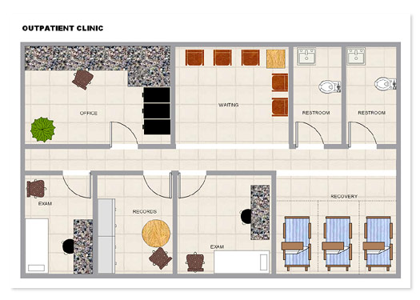
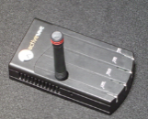
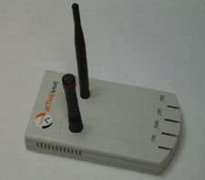


Monitoring Floor with Different Modes
Periodic Mode
Trigger Mode
Beacon Mode

Slide 7
Active Tag Applications
Hands-free Access Control
Patient / Employee Monitor
Equipment Tracking
Automatic In-room Billing
Supplies Inventory Control
Quarantine

Slide 8
Hands-free Access Control
With the long, adjustable range of active tags, active RFID systems can read tags within several feet of any door.
Active tags do not have to be manually placed close to the door Reader like passive tags.
Possible applications:
Control entry through locked doors to secured areas such as nurseries and labs.
Only allow newborns to leave with authorized people – dual tag validation.
Prevent Alzheimer’s and dementia patients from exiting hospital grounds.
Control employee-only doors and after-hours entries.

Slide 9
Patient / Employee Monitoring
The high power of active tags allow them to be reliably read when passing by Readers.
Possible applications:
Monitoring patients and employees throughout entire hospitals.
Locating patients and employees in any room or hallway.
Recording the movement of newborns and Alheimer’s patients throughout a facility.

Slide 10
Equipment Tracking
Active tags not only provide a unique ID to medical equipment, but can be used to track movement as well.
Possible applications:
Track movement and usage of equipment.
Locate missing equipment, e.g., system can read all equipment in several storage rooms simultaneously.

Slide 11
Automatic In-room Billing
Active tags provide an accurate history of time spent in each patient’s room.
Billing hours applied to doctors’ times and specific medical equipment usage.
Doctors and other specialists can have a reliable account of exactly how much time is spent per patient.
Heart monitors, drug carts, wheelchairs and other equipment time can be automatically billed to the correct patient.

Slide 12
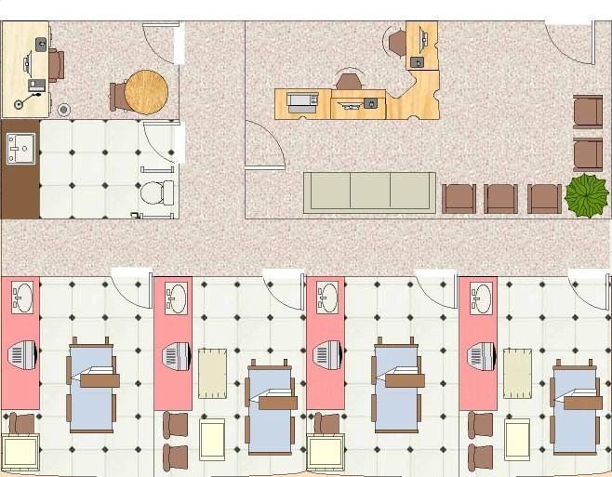
Example Active RFID Application
Asset Management
Identify tagged equipment using beacon mode.
Each tag periodically transmits its unique ID to Reader.
If tag does not “report in” by specified time, system will generate alarm.
RFID Active Reader

Slide 13
Zoning Example
Automatic inventory control
Read all tags periodically for real-time inventory control (periodic mode).
Install Readers in ceilings at Zone centers.
RFID Active Reader
Locate tags per zone
Find tagged goods instantly throughout entire facility per zone by manually activating each Reader (user mode).
Track movement from zone to zone
Detect movement with motion sensor activation (trigger mode).

Slide 14
Thank You
Your Total RFID Solutions Provider

